Slide 1
Atmospheric stability effects in FLORIS: how to add shear and veer? Pieter 11/25/2015

Slide 2
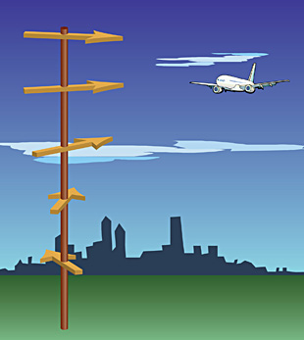
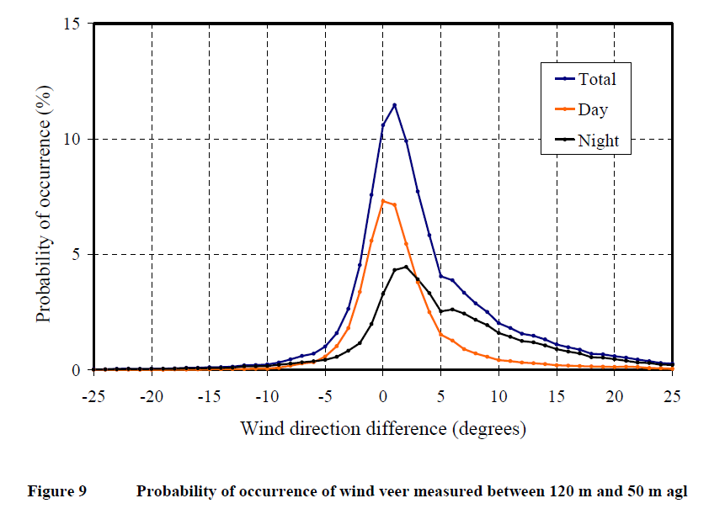
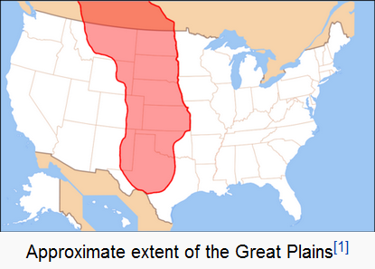
Stable Atmosphere → Wind Veer
In a stable atmosphere (hot above cold air), less mixing between lower and upper atmosphere, thus Earth-rotation induced wind direction not propagated to upper atmosphere → wind veer (wind direction shear)
WARM
very little mixing here..
COLD
Earth rotating
that way
my understanding of this…
← Measured somewhere here :
From: Effects of Complex wind regimes on Turbine Performance, Garrad Hassan America, Inc. AWEA WINDPOWER 2009

Slide 3
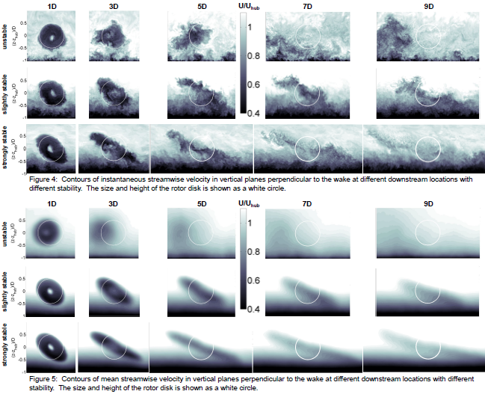
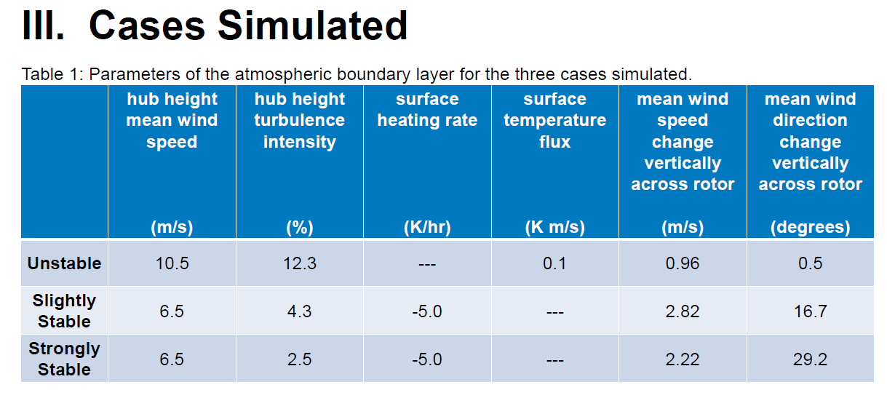
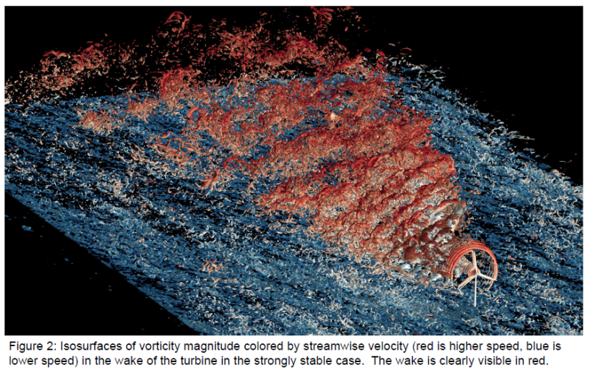
Wind Veer → Wake In-Plane Skew
From Matt’s poster:
Large-Eddy Simulations of Wind Turbine Wakes Subject to Different Atmospheric Stabilities
Now: how to characterize wind veer → wake in-plane skew effect in FLORIS?
Also, shear profile is important to take into account (fully 3D FLORIS)

Slide 4
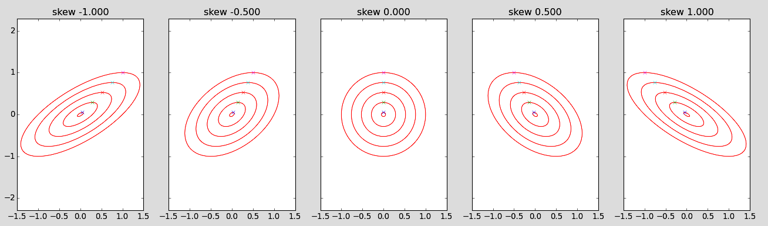





Skewing a circle..
$$phi$$
$$hs$$
$$h$$
$$w$$
$$ws$$
ellipse/circle with initial height hs and width ws and skew c, can be represented as rotated ellipse with angle phi, width w, height h
phi = atan((c^2*hs^2 - hs^2 + ws^2 + sqrt((c^2*hs^2 + hs^2 - 2*hs*ws + ws^2)*(c^2*hs^2 + hs^2 + 2*hs*ws + ws^2)))/(2*c*hs^2));
w = sqrt(hs^2*ws^2*(4*c^2*hs^4 + (c^2*hs^2 - hs^2 + ws^2 + sqrt((c^2*hs^2 + hs^2 - 2*hs*ws + ws^2)*(c^2*hs^2 + hs^2 + 2*hs*ws + ws^2)))^2)/(4*c^2*hs^6 + 2*c^2*hs^4*(4*c^2*hs^4 + (c^2*hs^2 - hs^2 + ws^2 + sqrt((c^2*hs^2 + hs^2 - 2*hs*ws + ws^2)*(c^2*hs^2 + hs^2 + 2*hs*ws + ws^2)))^2)*(c^2*hs^2 - hs^2 + ws^2 + sqrt(c^4*hs^4 + 2*c^2*hs^4 + 2*c^2*hs^2*ws^2 + hs^4 - 2*hs^2*ws^2 + ws^4))/(c^4*hs^4 + 2*c^2*hs^4 + 2*c^2*hs^2*ws^2 + c^2*hs^2*sqrt(c^4*hs^4 + 2*c^2*hs^4 + 2*c^2*hs^2*ws^2 + hs^4 - 2*hs^2*ws^2 + ws^4) + hs^4 - 2*hs^2*ws^2 - hs^2*sqrt(c^4*hs^4 + 2*c^2*hs^4 + 2*c^2*hs^2*ws^2 + hs^4 - 2*hs^2*ws^2 + ws^4) + ws^4 + ws^2*sqrt(c^4*hs^4 + 2*c^2*hs^4 + 2*c^2*hs^2*ws^2 + hs^4 - 2*hs^2*ws^2 + ws^4)) + c^2*hs^2*(c^2*hs^2 - hs^2 + ws^2 + sqrt((c^2*hs^2 + hs^2 - 2*hs*ws + ws^2)*(c^2*hs^2 + hs^2 + 2*hs*ws + ws^2)))^2 + ws^2*(c^2*hs^2 - hs^2 + ws^2 + sqrt((c^2*hs^2 + hs^2 - 2*hs*ws + ws^2)*(c^2*hs^2 + hs^2 + 2*hs*ws + ws^2)))^2))/2;
h = sqrt(hs^2*ws^2*(4*c^2*hs^4 + (c^2*hs^2 - hs^2 + ws^2 - sqrt((c^2*hs^2 + hs^2 - 2*hs*ws + ws^2)*(c^2*hs^2 + hs^2 + 2*hs*ws + ws^2)))^2)/(4*c^2*hs^6 + 2*c^2*hs^4*(4*c^2*hs^4 + (c^2*hs^2 - hs^2 + ws^2 - sqrt((c^2*hs^2 + hs^2 - 2*hs*ws + ws^2)*(c^2*hs^2 + hs^2 + 2*hs*ws + ws^2)))^2)*(c^2*hs^2 - hs^2 + ws^2 - sqrt(c^4*hs^4 + 2*c^2*hs^4 + 2*c^2*hs^2*ws^2 + hs^4 - 2*hs^2*ws^2 + ws^4))/(c^4*hs^4 + 2*c^2*hs^4 + 2*c^2*hs^2*ws^2 - c^2*hs^2*sqrt(c^4*hs^4 + 2*c^2*hs^4 + 2*c^2*hs^2*ws^2 + hs^4 - 2*hs^2*ws^2 + ws^4) + hs^4 - 2*hs^2*ws^2 + hs^2*sqrt(c^4*hs^4 + 2*c^2*hs^4 + 2*c^2*hs^2*ws^2 + hs^4 - 2*hs^2*ws^2 + ws^4) + ws^4 - ws^2*sqrt(c^4*hs^4 + 2*c^2*hs^4 + 2*c^2*hs^2*ws^2 + hs^4 - 2*hs^2*ws^2 + ws^4)) + c^2*hs^2*(c^2*hs^2 - hs^2 + ws^2 - sqrt((c^2*hs^2 + hs^2 - 2*hs*ws + ws^2)*(c^2*hs^2 + hs^2 + 2*hs*ws + ws^2)))^2 + ws^2*(c^2*hs^2 - hs^2 + ws^2 - sqrt((c^2*hs^2 + hs^2 - 2*hs*ws + ws^2)*(c^2*hs^2 + hs^2 + 2*hs*ws + ws^2)))^2))/2;
Thanks SymPy!

Slide 5
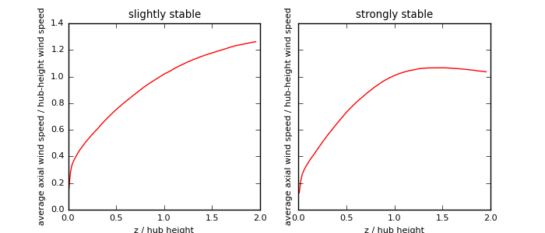
Including wind shear in FLORIS
Simply apply shear profile as taken from SOWFA (wind speed scaling with height, relative to hub-height speed)
Might use parametric formulations later [link]

Slide 6
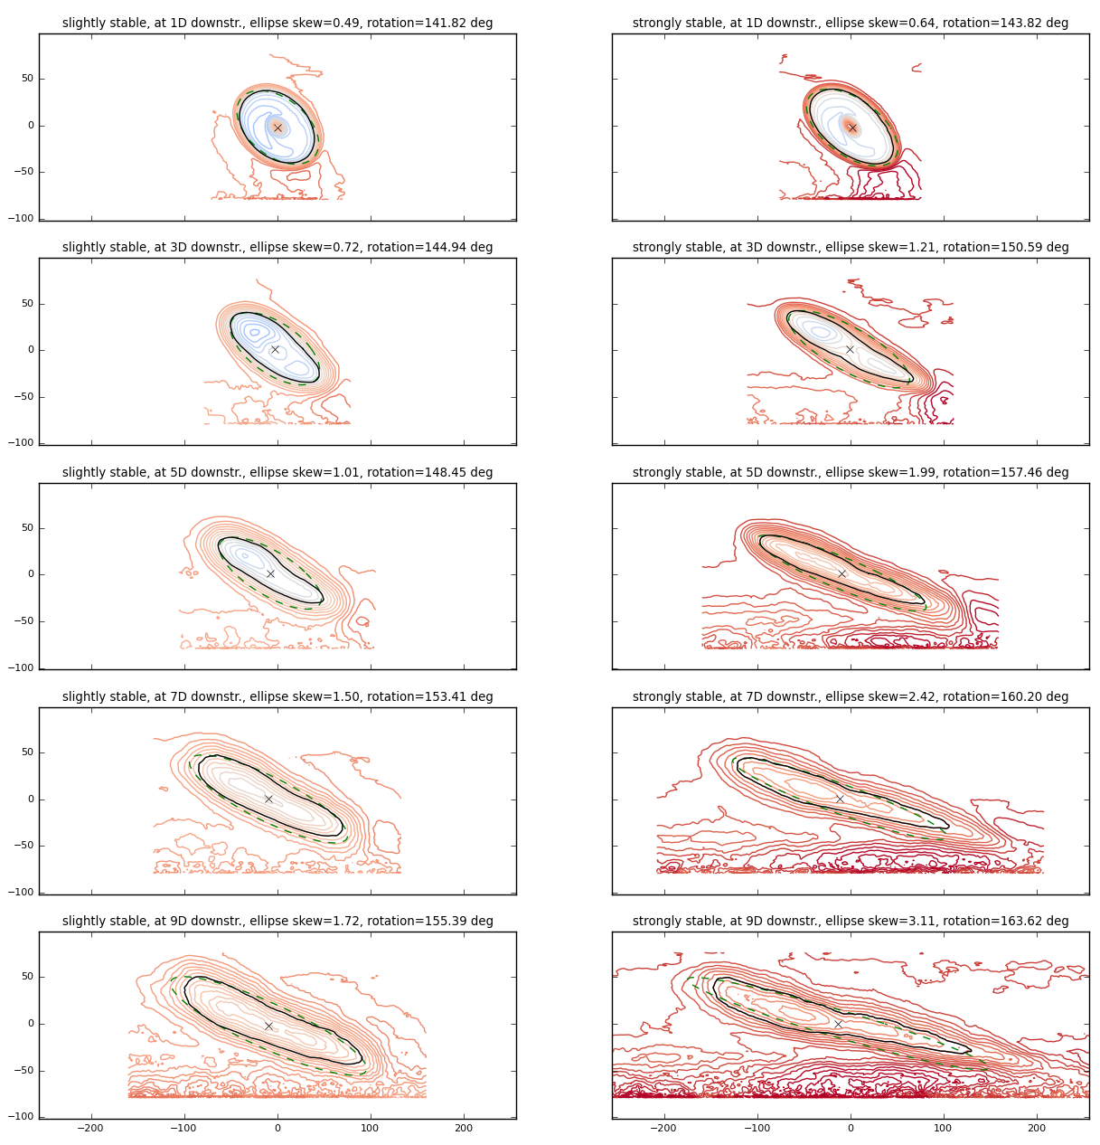
Estimating the skew from wake contours
Take contour plot of wake velocity at cut-throughs with shear removed
Estimate phi from left-upper point of wake contour to calculate skew

Slide 7
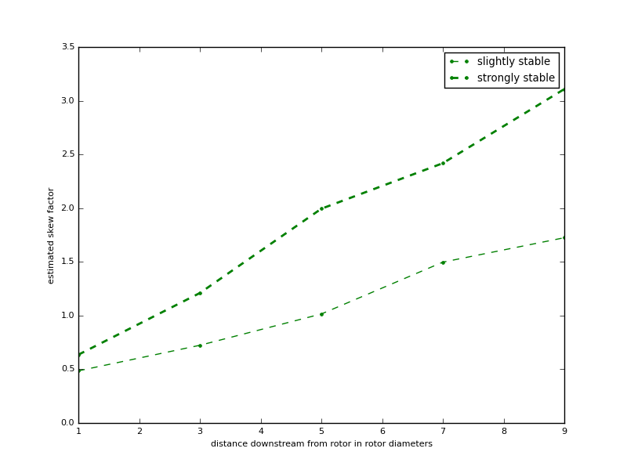
Estimated skew vs. distance to rotor

Slide 8
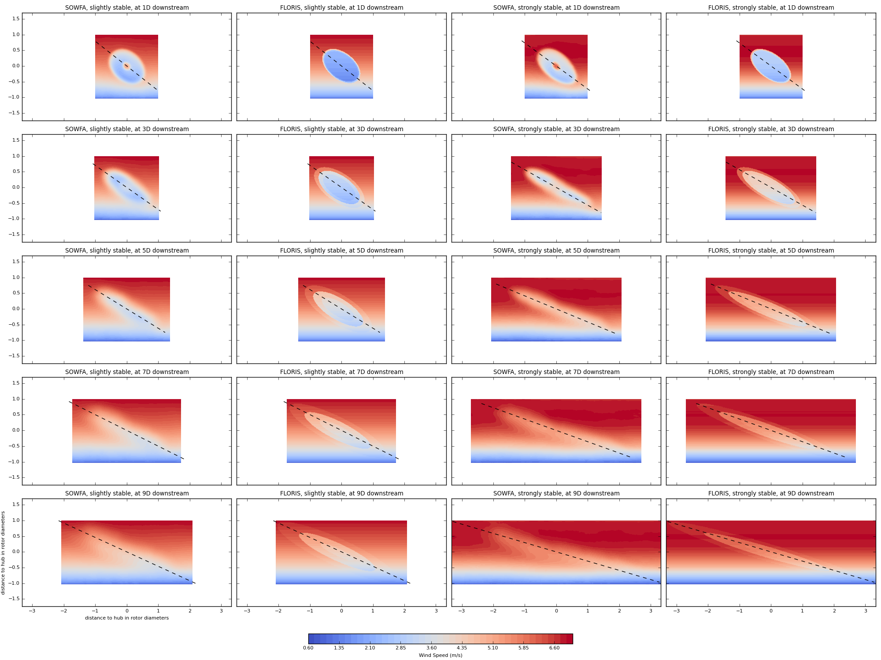
Finally, tune recovery of each wake zone to find velocity profiles

